Slide 1


Neural Machine Translation and AI
Presented by: Amit Tomar (CS-A, 2nd year)
Presented to: Mrs. Shalini Puri

Slide 2
Outline
Introduction to NMT
How does NMT work?
Applications of NMT
Ending Keynote

Slide 3
What is Neural Machine translation (NMT)?
Machine Translation (MT) is a subfield of computational linguistics that is focused on translating text from one language to another.

Slide 4
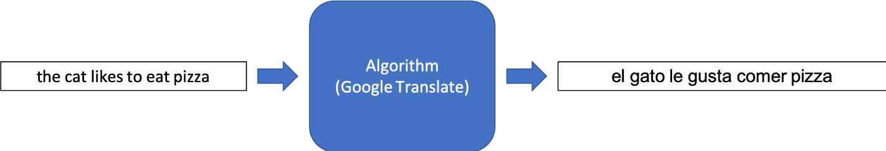
Unlike statistical machine translation, which consumes more memory and time, neural machine translation, NMT, trains its parts end-to-end to maximize performance.
“Google Translate is the leading industry example of NMT”

Slide 5
How does NMT works?
Unlike traditional methods of machine translation that involve separately engineered components, NMT works cohesively to maximize its performance.
Additionally, NMT employs the use of vector representations for words and internal state. This means that words are transcribed into a vector defined by a unique magnitude and direction.

Slide 6
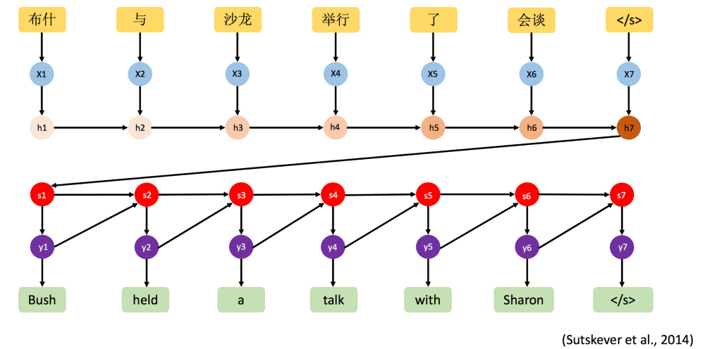
1

Slide 7
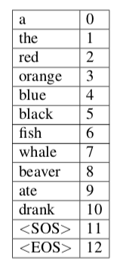
One of the older and more established versions of NMT is the Encoder Decoder structure.
To understand how we can then use a Vocabulary to create One Hot Encoding vectors for every word in our dataset, consider a mini-Vocabulary
Mini-vocabulary for the English language used in NMT

Slide 8
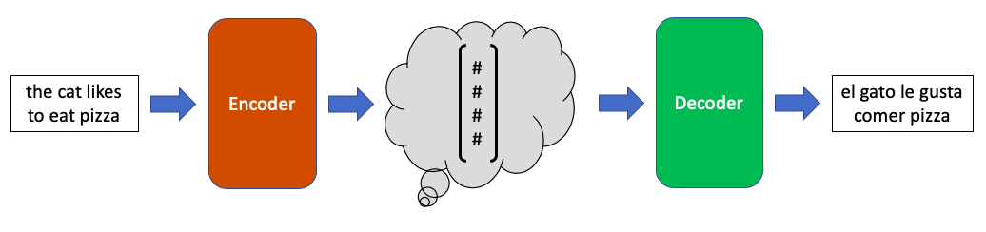
Encoder Decoder structure translating the English sentence “the cat likes to eat pizza” to the Spanish sentence “el gato le gusta comer pizza”

Slide 9
Applications of Neural Machine translation
Machine Translation in Industry for Business Use
Online / App Machine Translation for Consumer Use
Google Translate
Facebook Translate
Real-Time Speech-to-Speech Translation
“Wearable” Voice Translator Device

Slide 10
What next?
The NMT revolution was started by Google with Google translate but now every tech giant and even some of the startups are entering in this field.
There are some errors in most of the translations but companies are working to make it ,more perfect day by day.

Slide 11
Questions?

Slide 12
References
https://towardsdatascience.com/neural-machine-translation-15ecf6b0b
https://deepai.org/machine-learning-glossary-and-terms/neural-machine-translation
https://analyticsindiamag.com/googles-new-ai-milestone-neural-machine-translation-engine-can-now-translate-103-languages/

